Slide 1
CATEGORIES & ENTRY GUIDELINES
D SHOW 2023

Slide 2
ABOUT THE D SHOW AWARDS
The D Show recognizes the amazing breadth and depth of the creative talent in Detroit.
It’s true, we create a lot of really great sh*t and the D Show is designed to be a celebration of ideas that are conceptually amazing AND well executed. Yes, it’s that super-powerful and uber-magical combination of both that will earn you that highly coveted, and kinda heavy for its size, D award.
In each and every category, and for our Best Of Show, we truly want it to be all about honoring the creamiest of the crop. So, may the best idea, executed the best, win.

Slide 3
WHO CAN AND SHOULD ENTER
The D Show call for entries is proudly open to any Detroit-based agency, client, design studio, broadcaster, publisher, production house, freelancer, student artist or individual responsible for the development and/or execution of creative work.
All work must fall within the outlined categories (more to come on these in a sec). All entries must have been first published, posted or aired in their original form between January 1, 2022 and December 31, 2022 in a form of media and/or exposed to a substantial audience.
The creative concept must have roots in Detroit, whether it’s work from a Detroit-based agency, production company, or post facility for a Detroit-based client. The D Council reserves the right to request proof of initial publication, posting or airdate, as well as proof of creation or production dates. Any submissions that have been previously entered in the D Show and are materially unchanged will not be eligible.

Slide 4
WHO PICKS WHAT WINS
Winning a D Show award is kind of a big deal.
That’s because we work hard to get a wide variety of kick-ass judges from a wide variety of big-name ad and experience agencies, hot design firms, cool creative boutiques,
and killer production companies from across the U.S. and around the world.
Oh, and we tell all of our judges to not hold any punches. We want them to hold the stuff coming out of the D to a super-high standard, and so we insist they treat the work as if they were judges for any big award show (you know the ones).

Slide 5
DEETS ON KEY DATES
CALL FOR ENTRIES 2023
OPEN: January 13, 2023
1st DEADLINE: February 3rd, 2023
2nd DEADLINE w/ Price Increase to $175: February 10th, 2023
FINAL DEADLINE: February 17th, 2023
FINAL, FINAL DEADLINE, w/ 2nd Price Increase to $250: Monday, February 27th, 2023
D SHOW: Gem Theater: JUNE 1st, 2023

Slide 6
THE MONEY STUFF Enter early, enter often, oh, and be sure to enter multiple categories to up your chances to bring even more D’s home.
SINGLE OR CAMPAIGN
February 3rd, 2023 – 5:00 PM EST (Initial Deadline) $125
February 10th, 2023– 5:00 PM EST (Extended Deadline) $175
February 27th, 2023– 5:00 PM EST (Last Chance) $200
INTEGRATED CAMPAIGN
Entered by regular deadline, 2/3/23: $275
Entered by extended deadline, 2/10/23: $325
Entered by FINAL deadline, 2/27/23: $350
STUDENT ENTRIES & 1st Time Entries.
Free

Slide 7
DEETS ON KEY DATES
SHORTLIST ANNOUNCED
The wait is over. You’ll find out if your stuff got shortlisted via email, Friday, April 14th, 2023
BEST OF CATEGORY NOMINEES ANNOUNCED
Sometime in May, the nominees vying for Best Of in their respective categories will be dramatically revealed. And by dramatic, we mean on social. Oh, and spoiler alert:
If your work is a Best Of nominee that means you won a D Award in this category. Yeah, you.
BEST OF CATEGORY AND BEST OF SHOW WINNERS ANNOUNCED
Of course, it all comes down to who’s bringing home the serious hardware and that goes down at the D Show, Thursday, June 1st.
Follow @AdcraftDetroit on social media for the latest details on D Show 2023.

Slide 8
THE TECH SPECS
VIDEO
Upload standard definition or HD video files. Iceberg, our online entry system provider, is powered by Vimeo. Use this URL for video compression recommendations directly from Vimeo to ensure your videos are presented as clearly as possible: https://vimeo.com/help/compression. There is a maximum video file size of 1GB.
AUDIO
Upload an uncompressed audio file like .WAV files or compressed audio like .MP3 files. There is a maximum audio file size of 25MB.
IMAGE
Attach image files including .GIF, .JPG or .PNG files. There is a maximum image file size of 25MB.
DOCUMENT
Use the document fields to upload any .PDF files. There is a maximum document file size of 25MB.
URL
Attach a URL/website address to your entry. It does not matter if you include http or https before it.

Slide 9
GOT A QUESTION (DON’T BE SHY)?
Please shoot any questions regarding entries, categories, really anything D Show-related to:
Lauren Hustek
Adcraft Executive Director
lauren@adcraft.org
OR
Chris Handyside
D Show Chair
Christopher.handyside@leoburnett.com

Slide 10
THE CATEGORIES
Each piece of work entered into a category can win a D award – and if it does, it will have also a chance to win a “Best Of” D Award for that category.
Plus, each Best Of category winner is then considered for the Best Of Show award.
Below are the categories. Keep reading, and you’ll see we give you simple and clear descriptions for what type of work should be entered for each.
1.TV | Video | Moving Picture
2. Print
3. Integrated Campaigns
4. Digital
5. Mobile
6. Experiential | Live Shows
7. Craft
8. Social Impact
9. Audio Marketing
10. Self Promotion
11. Creative use of Media
11. Branded Entertainment
13. Public Relations
14. Low Budget
15. D-Versity
16. Detroit Love
17. Student

Slide 11
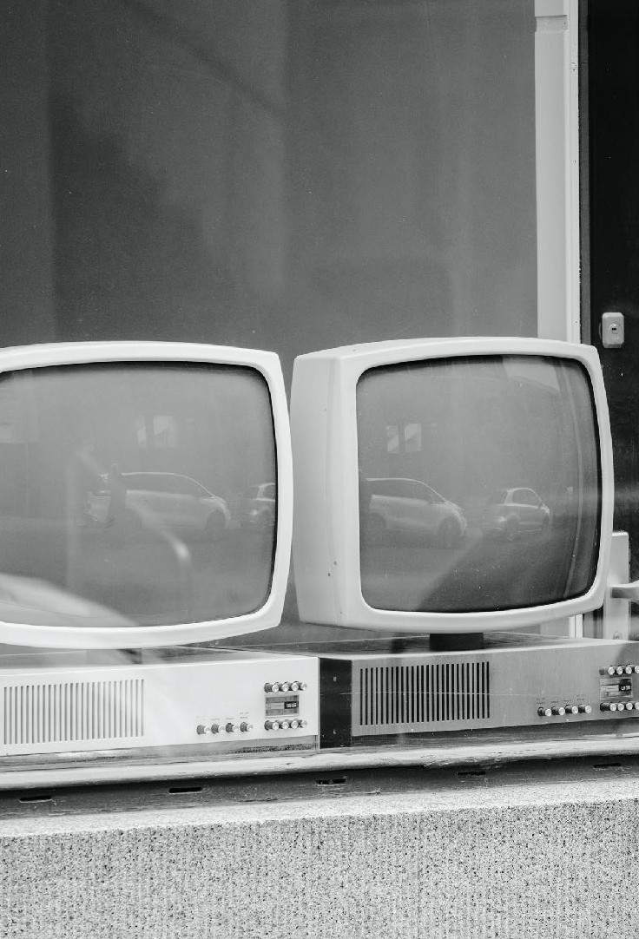
TV | Cinema
This includes any moving picture, be it a TV spot or online video.
You may enter in the following sub-categories:
TV/Cinema
Non-Broadcast Video
Online/Virtual Video
In these three subcategories are different lengths you can enter:
:30 and under
:60 or longer
TV/Cinema
ideo
Online / Virtual Video
Photo by Daniel von Appen on Unsplash

Slide 12
PRINT
If it was printed, whether it be offset, digital, screen or other, you can enter it here. That means magazine or newspaper ads (of any size, and again, it could be a single execution or campaign), OOH, POS, posters, even direct mail.
Photo by Bank Phrom on Unsplash

Slide 13
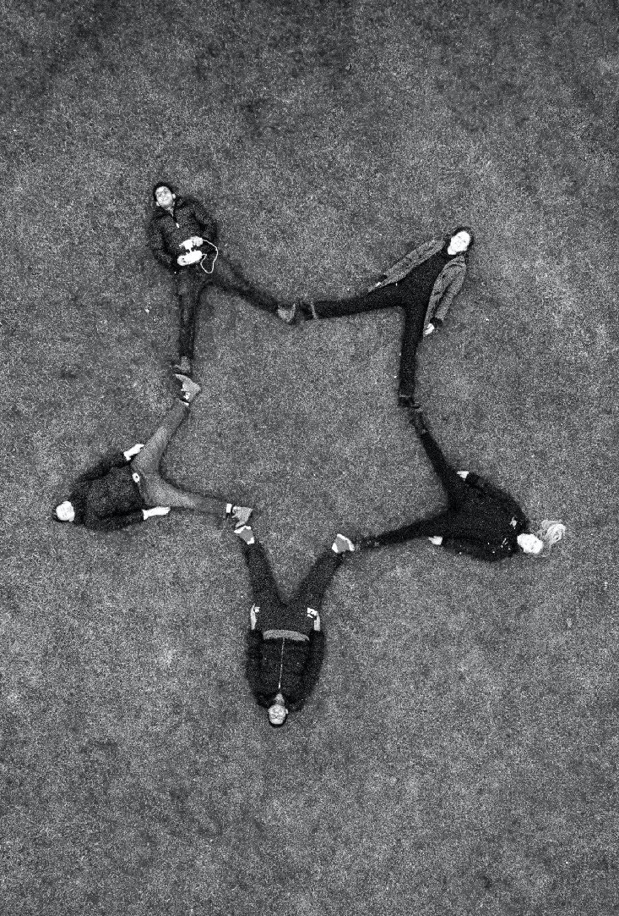
INTEGRATED CAMPAIGNS
Some of our best work and best ideas live in a multitude of mediums, so we want to be sure to give props to those who come up with the ideas big enough to be great across them all. These campaigns must have found a home in at least three different mediums. This is where a really great case study video can do wonders for your chances.
Photo by Sidharth Bhatia on Unsplash

Slide 14
DIGITAL
Yes, it seems this digital thing is really catching on and likely here to stay, so good thing there are plenty of talented folks who are doing a lot of great stuff that engages their audiences on devices and their respective platforms. By devices, we're talking about things like smart phones and computers and platforms including sites, social things like Instagram, Facebook and Snapchat and let's not forget the occasional amazing app.
You may enter in the following sub-categories:
Website
Online Advertising
Social - Tik Tok / Facebook / Twitter / Instagram, Snapchat etc.
Apps + Games
Mobile
Photo by Federica Galli on Unsplash

Slide 15
MOBILE
That phone that you can’t seem to put down, well people are making some really cool things with it. Everything from virtual reality experiences that blow your mind to apps that help you not lose it. It can be a game, a killer video, the use of QR code, anything you made that was specific to a mobile experience If it appeared on a smart phone – even a flip phone – it’s got a home right here.
Photo by Rodion Kutsaev on Unsplash

Slide 16
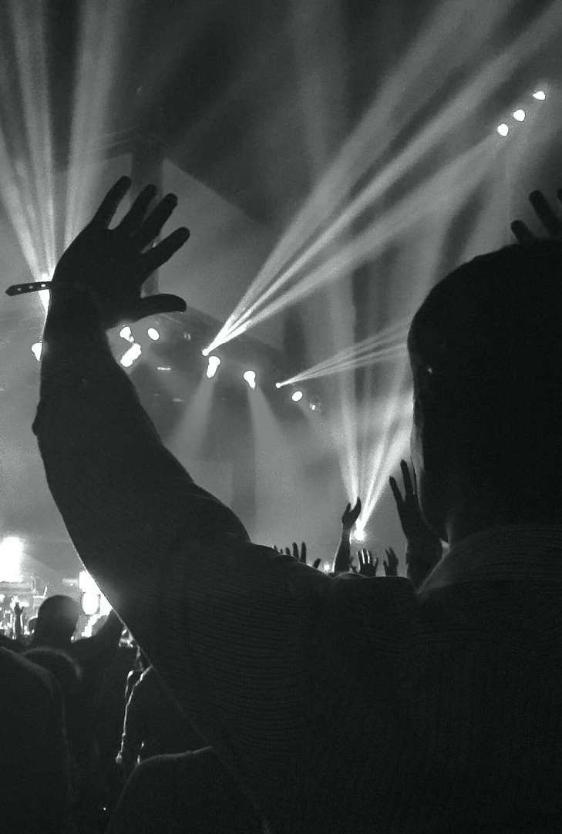
EXPERIENTIAL
What's the saying now, people are more about consuming and having experiences than things? And that holds true for how people engage with brands who want to communicate through live experiences. You should enter here if your idea is something that is 'experienced' - you know, like events, business conferences, trade shows, pop-up stores a festival or similar with a great idea at the center of it all. This category is a celebration of the best “live” experiences, perhaps utilizing technology within the experience to reach a wider audience and deliver a measurable game- changing result for your clients. (not about results). We know that in the past few year things have shifted in the world, so this also includes all those virtual “live” events.
Subcategories:
Events/Activations
Live Shows
AR/VR/Metaverse
Photo by Melissa Askew on Unsplash

Slide 17
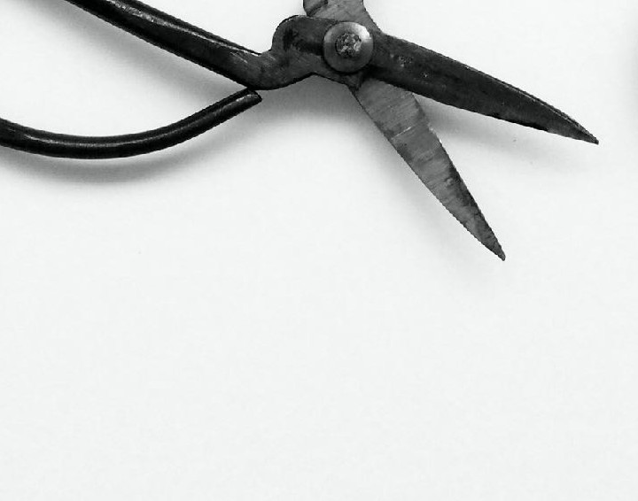
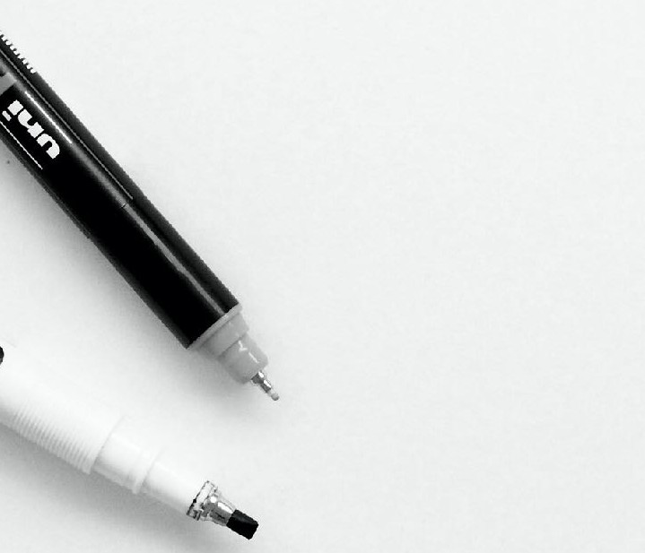
CRAFT
A lot of times, the execution of the best big ideas all comes down to the attention paid to even the smallest of details. The colors, the sound, the words, the pace, the art and design, every part, every piece, every pixel painstakingly considered. This is the category where judges will be asked to truly focus on those very details, be it the color correction, sound design, music choice (original score or the perfectly chosen licensed track), photography, or maybe the fantastic frame f*cking that went into the edit, any or all of it that helped create something we can all agree (or at least the judges do) is well crafted. When you enter, you'll be asked to check a box for what part of the craft the judges should really focus on. You may enter in the following sub-categories:
Editing
Photography
Cinematography Graphic Design
Original Music
Sound Design
Motion Post (Including CGI, FX, Color)
Photo by Plush Design Studio on Unsplash

Slide 18
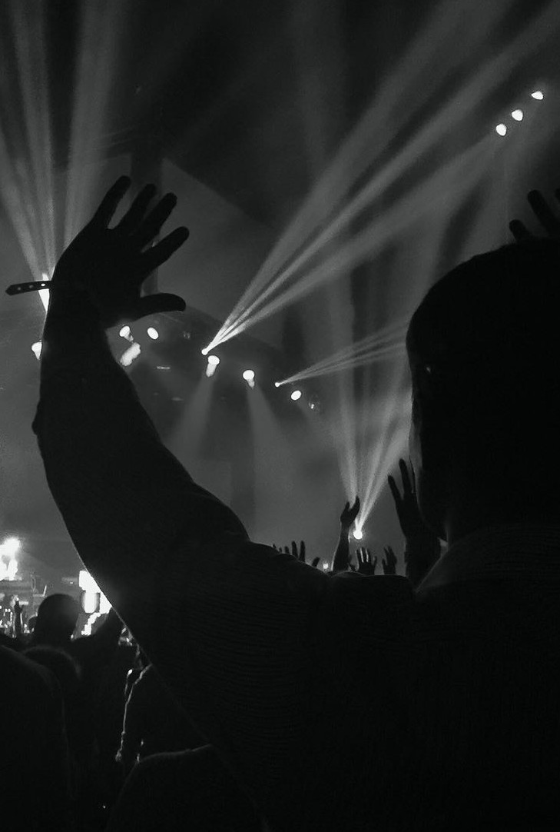
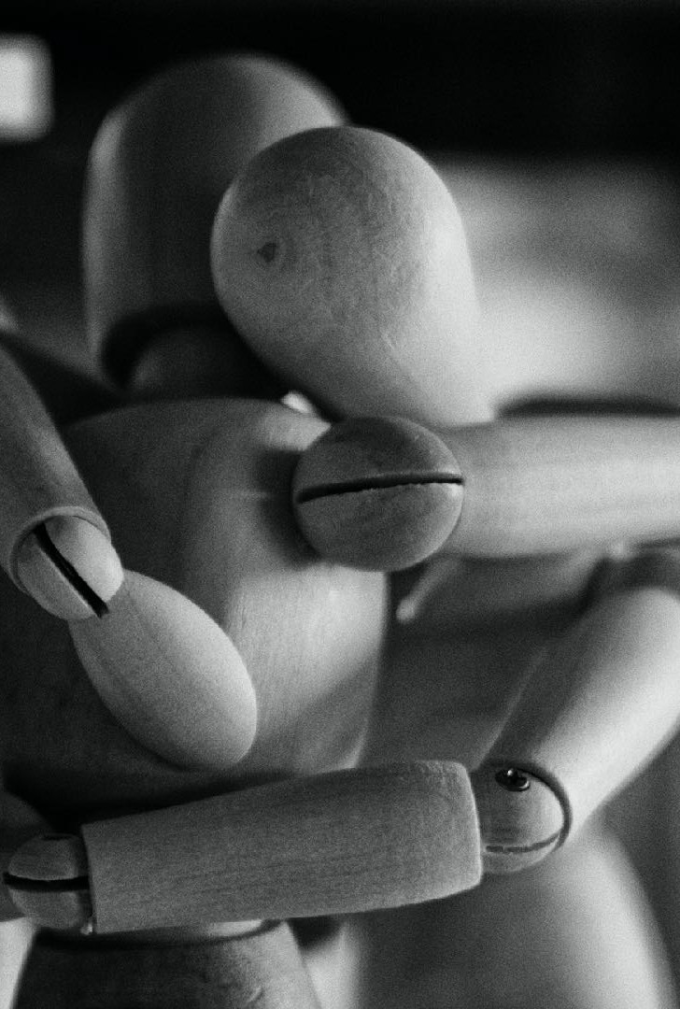
SOCIAL IMPACT
Coming up with (and often pro bono-ing) big ideas and amazing work (in any form or medium) to help a worthy cause, company or charity/non-profit promote its mission to make the world a better place is indeed a noble deed. And we think
the greatest of this good works stuff should get a big ol’ shout out and be rewarded with a heavy metal D.
Photo by Marco Bianchetti on Unsplash
Photo by Marco Bianchetti on Unsplash

Slide 19
AUDIO MARKETING
Yep, this category used to be call “radio,” but now there so many ways we use sound and audio to get our marketing messages out there – radio spots (both those played on the air and over the internet), branded podcasts, podcast pre, mid and post rolls, branded audio books and storytelling - even audio that brings a physical experience to life. If it’s music to people’s ears (sometimes literally, and definitely metaphorically) it gets entered here.
Photo by Akshay M on Unsplash

Slide 20
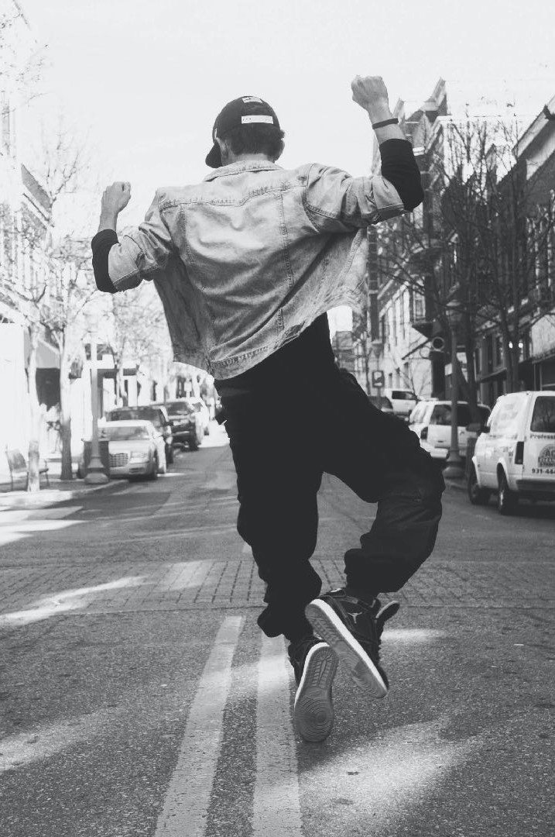
CREATIVE USE OF MEDIA
Sometimes the best ideas come from the wacky or interesting ways you develop work for a specific platform or media channel. If you came up with a killer way to make your brand stand out in a social feed or used a podcast to launch a new car or Tik Tok to convince kids to eat green beans, you should enter it here.
Photo by Andre Hunter on Unsplash

Slide 21
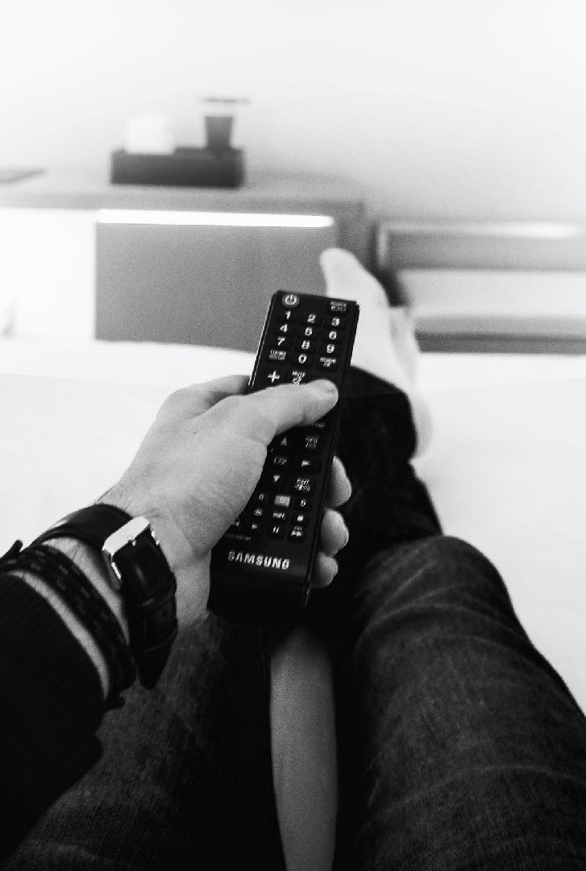
BRANDED ENTERTAINMENT
Branded Entertainment recognizes the merging of advertising and entertainment content. It includes work that is built around a brand or product and goes beyond traditional product placement or sponsorship.
Photo by Clément M. on Unsplash

Slide 22
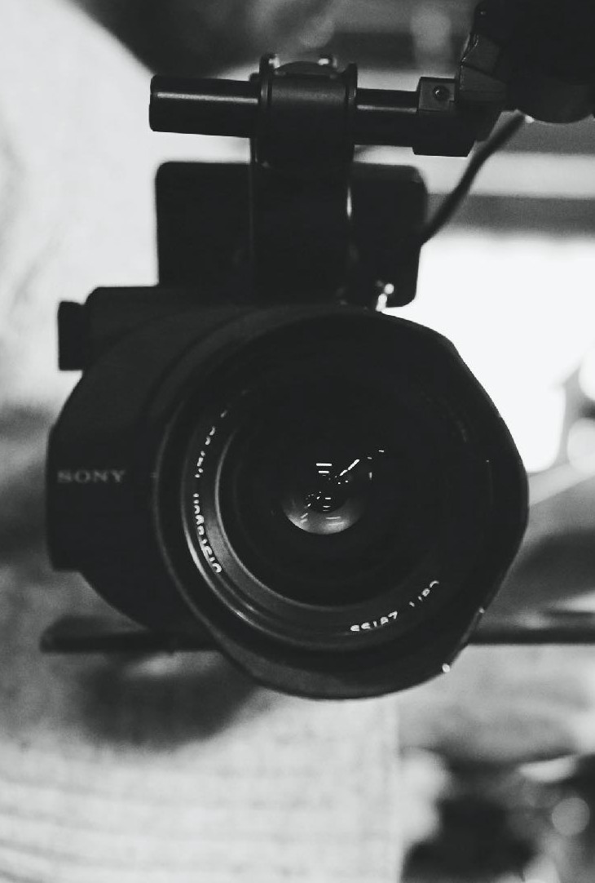
PUBLIC RELATIONS
Strategies and ideas that use PR methods as creative tools. Judges will be looking for innovative and creative ‘PR first’ ideas – those which prioritize the effective use of PR strategy to communicate the brand message.
Photo by Laura Lee Moreau on Unsplash

Slide 23
LOW BUDGET
Yeah, there are still the occasional jobs that have big (or at least pretty decent) budgets, but it’s becoming a lot more typical for us to be calling in favors and trying to find ways to stretch a few modest bucks to create something remarkable.
We believe these low-dollar, still-big-idea efforts should be rewarded – and not asked to go head-to-head with those chosen few jobs that are still properly funded.
You may enter in the following sub-categories:
TV/Video/Moving Picture: All in under $50K Print: All in under $5K
Audio Marketing: All in under $10K Integrated: All in under $50K
Photo by Fabian Blank on Unsplash

Slide 24
D-VERSITY
Recognizes an inclusive campaign that demonstrates a deep understanding of a specific diverse or multicultural consumer groups including consumers of color, race, gender, age, differently abled individuals, LGBTQIA+ and immigrants.
Photo by Northernstar-online.com

Slide 25
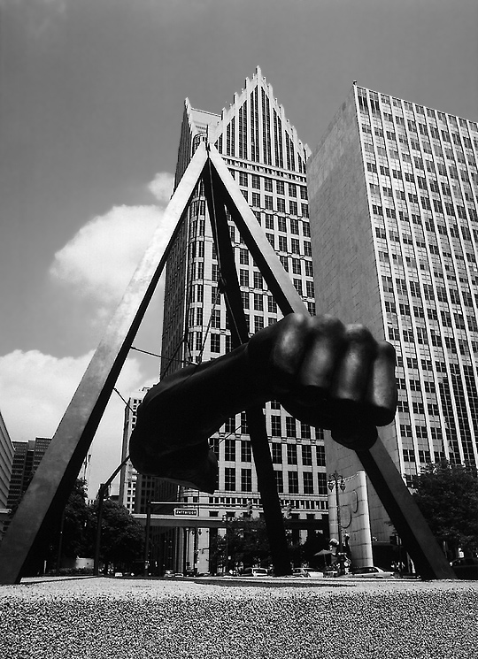
DETROIT LOVE
Work that promotes or elevates our great city of Detroit. Ideas that promote our culture, work ethic, history and/or vibe. This work can be viewed locally or nationally. Video. Print. Social. Cause Marketing, Promotional, Event and Experiential. You made it. Enter it.
Photo on Deamstime.com 61875499

Slide 26
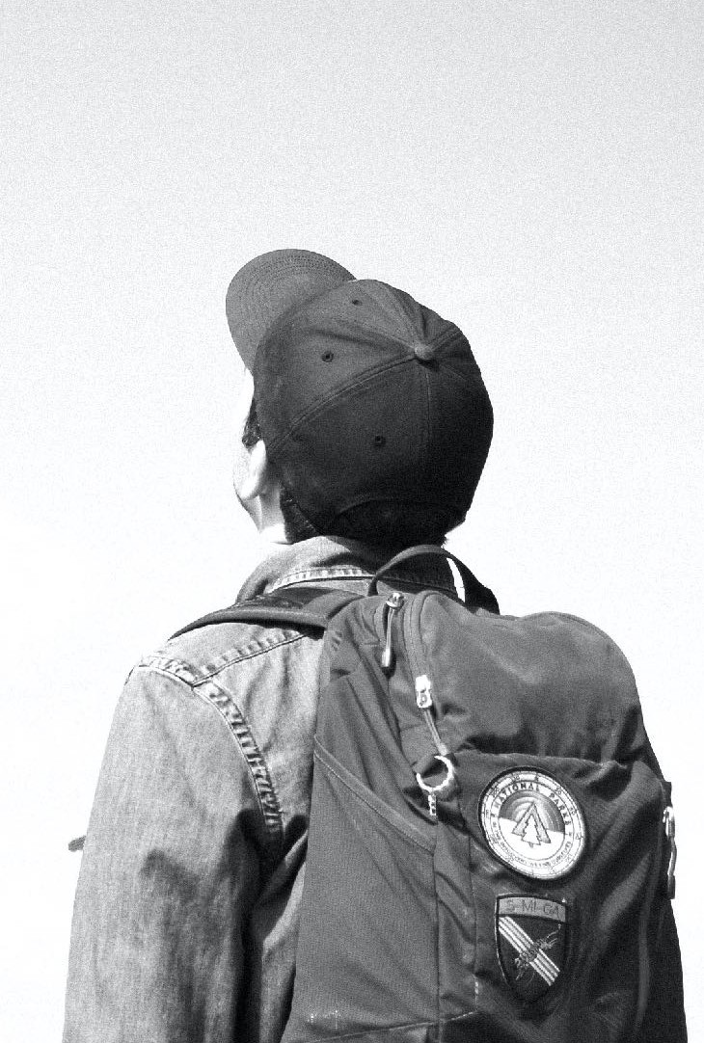
STUDENT
Easily one of our favorite categories, as it’s always amazing to see the incredible ideas that the next gen of ad folks are coming up with – whether it’s an official part of a school project or something they just did all on their own as a student side hustle.
Not only are we continually impressed with the thinking and bigness of these ideas, but how truly resourceful students can be when it comes to executing them and making them feel like work done for real clients – because sometimes they are.Oh, and another thing: We’re going to award a Best Of in the Student category. Nice.
Print
Video
Social
Integrated
Photo by Matese Fields on Unsplash

Slide 27
THANKS. AND GOOD LUCK.

